Slide 1



CORONA VIRUS
ANALYSIS
Presented by Aakash Dev R

Slide 2

CORONA VIRUS
The CORONA VIRUS (Covid-19) pandemic has had a significant impact on public health and has created anurgent need for data driven insights to understand the spread of the virus. As a data enthusiast, I have assigned a task to analyze the corona virus dataset and to derive meaningful insights from this data.

Slide 3
DATA DESCRIPTION
Dataset :
Description of each column in dataset:
Province: Geographic subdivision within a country/region.
Country/Region: Geographic entity where data is recorded.
Latitude: North-south position on Earth's surface.
Longitude: East-west position on Earth's surface.
Date: Recorded date of CORONA VIRUS data.
Confirmed: Number of diagnosed CORONA VIRUS cases.
Deaths: Number of CORONA VIRUS related deaths.
Recovered: Number of recovered CORONA VIRUS cases.

Slide 4
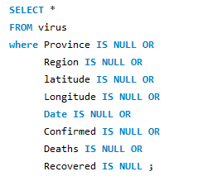
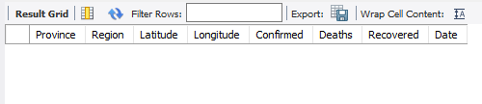
Query 1
To avoid any errors, check missing value / null value
Write a code to check NULL values
Inference :
There is no missing/null values present in the data.

Slide 5
Query 2
If NULL values are present, update them with zeros for all columns.
Inference :
Since there is no missing/null values present in the data, we don’t need to update them to zeros for all columns.

Slide 6
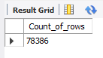
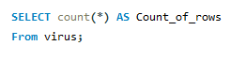
Query 3
Check total number of rows
Inference :
The query executed and results in the output as total count of rows is 78,386.

Slide 7
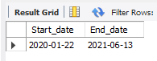
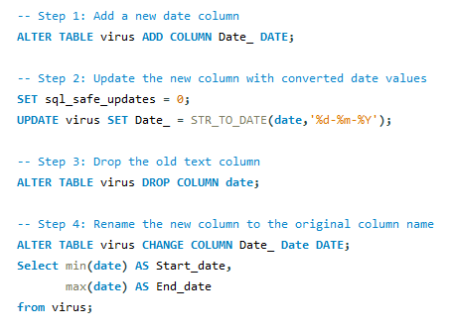
Query 4
Check what is start_date and end_date
Inference :
Since the data has different 'date' format it need to be updated to the required format.
By default the SQL has safe mode enabled which prevents the data's being updated so it needs to be turned off before we update the date format.
Start date of corona is 2020-jan-22.
End date of corona is 2021-jun-13
As per the dataset..

Slide 8
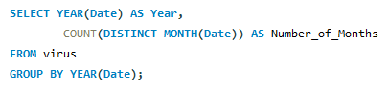
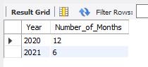
Query 5
Number of month present in dataset
Inference :
The total number of months in the year 2020 was 12 months and in the year 2021 was 6 months.

Slide 9
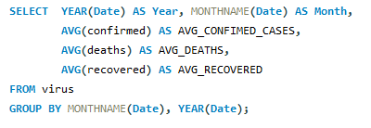
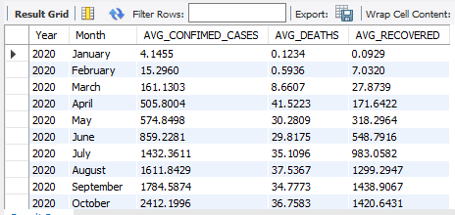
Query 6
Find monthly average for confirmed, deaths, recovered

Slide 10
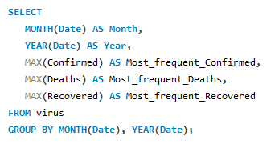
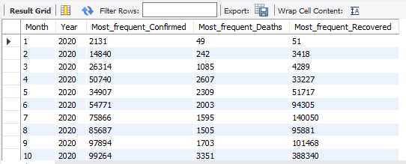
Query 7
Find most frequent value for confirmed, deaths, recovered each month

Slide 11
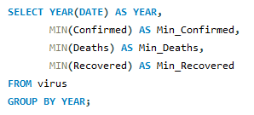
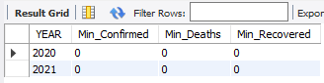
Query 8
Find minimum values for confirmed, deaths, recovered per year

Slide 12
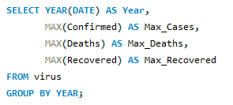
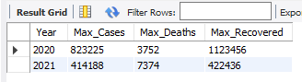
Query 9
Find maximum values of confirmed, deaths, recovered per year

Slide 13
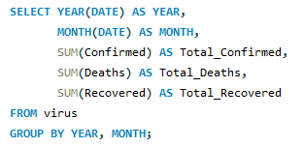
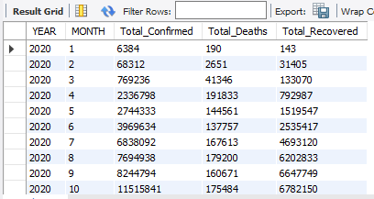
Query 10
The total number of case of confirmed, deaths, recovered each month

Slide 14
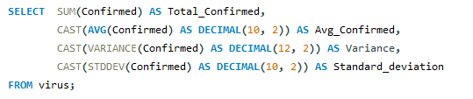
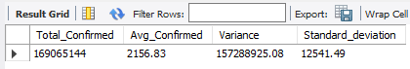
Query 11
Check how corona virus spread out with respect to confirmed case

Slide 15
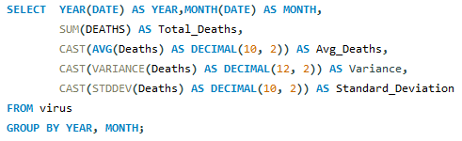
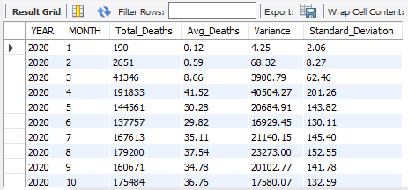
Query 12
Check how corona virus spread out with respect to death case per month

Slide 16
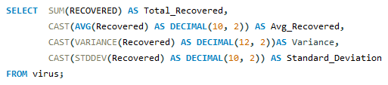
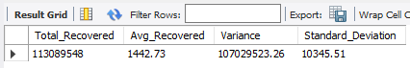
Query 13
Check how corona virus spread out with respect to recovered case

Slide 17
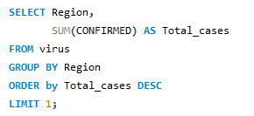
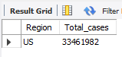
Query 14
Find Country having highest number of the Confirmed case

Slide 18
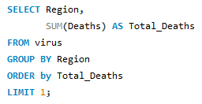
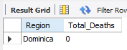
Query 15
Find Country having lowest number of the death case

Slide 19
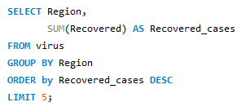
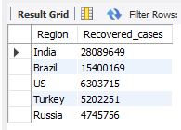
Query 16
Find top 5 countries having highest recovered case

Slide 20
﻿THANK YOU
“ We appreciate your time and engagement with our findings”

